Slide 1
Modern Machine Learning — Regularization and Overfitting/Underfitting
Kenneth E. Barner
Department of Electrical and Computer Engineering
University of Delaware

Slide 2
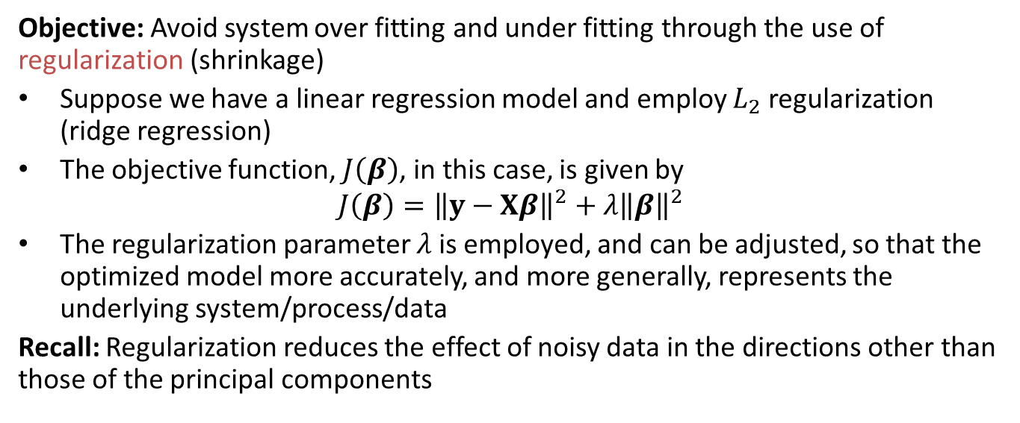
Regularization and Overfitting/Underfitting
Objective: Avoid system over fitting and under fitting through the use of regularization (shrinkage)
Suppose we have a linear regression model and employ $L_{2}$ regularization (ridge regression)
The objective function, $J\left(β\right)$, in this case, is given by
$${J\left(β\right)=\left\|y−Xβ\right\|}^{2}+λ{\left\|β\right\|}^{2}$$
The regularization parameter $λ$ is employed, and can be adjusted, so that the optimized model more accurately, and more generally, represents the underlying system/process/data
Recall: Regularization reduces the effect of noisy data in the directions other than those of the principal components

Slide 3








Regularization and Overfitting/Underfitting
Regularization and Overfitting/Underfitting
Example: General effects of the regularization parameter $λ$
$$f(x)$$
$$f(x)$$
$$f(x)$$
$$x$$
$$x$$
$$x$$
Overfit, $λ≈0$
Desired, proper value $λ$
Underfit, $λ→∞$

Slide 4






Regularization and Overfitting/Underfitting
Regularization and Overfitting/Underfitting
Suppose we have a ridge regression model (illustration purposes)
Training error: $J_{train}\left(β\right)=\frac{1}{2}{\left\|y_{train}−X_{train}β\right\|}_{2}^{2}+λ{\left\|β\right\|}^{2}$
Validation error: $J_{val}\left(β\right)=\frac{1}{2}{\left\|y_{val}−X_{val}β\right\|}_{2}^{2}+λ{\left\|β\right\|}^{2}$
Error
$$J_{val}\left(β\right)$$
Region 1
Underfitting, $J_{train}\left(β\right)$ and $J_{val}\left(β\right)$ high
Region 2
Overfitting, $J_{train}\left(β\right)$ low and $J_{val}\left(β\right)$ high
Region 3
Desired, $J_{train}\left(β\right)$ and $J_{val}\left(β\right)$ low
$$J_{train}\left(β\right)$$
Regularization parameter $λ$
Observations: In general, $J_{train}\left(β\right)$, is non-decreasing, while $J_{val}\left(β\right)$ is often “convex” with a minimum point

Slide 5
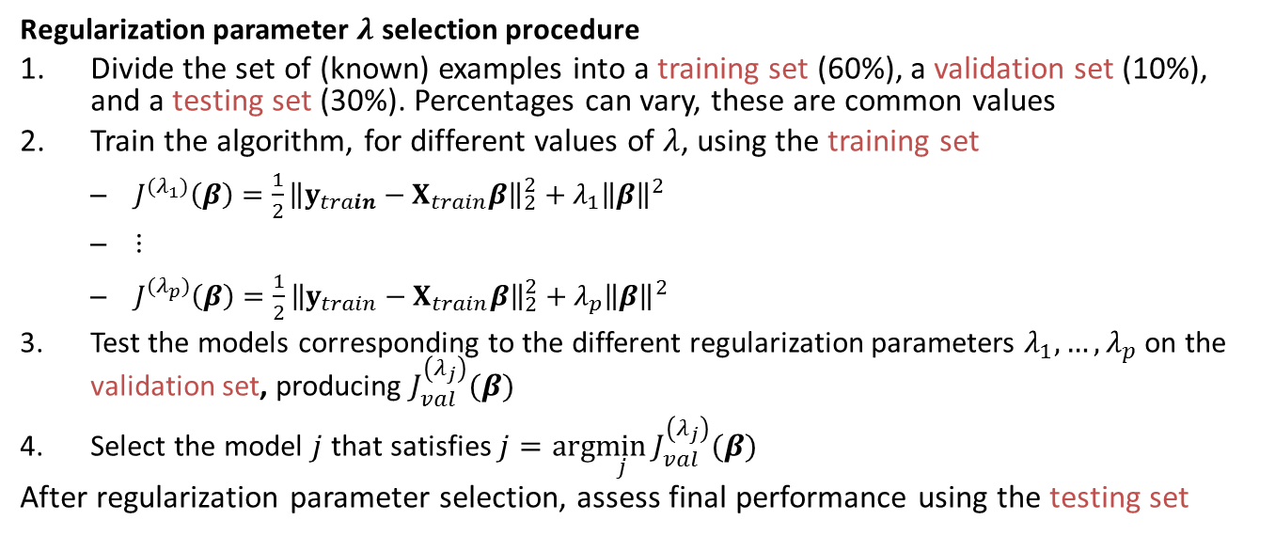
Regularization and Overfitting/Underfitting
Regularization parameter $λ$ selection procedure
Divide the set of (known) examples into a training set (60%), a validation set (10%), and a testing set (30%). Percentages can vary, these are common values
Train the algorithm, for different values of $λ$, using the training set
$J^{{(λ}_{1})}\left(β\right)=\frac{1}{2}{\left\|y_{train}−X_{train}β\right\|}_{2}^{2}+λ_{1}{\left\|β\right\|}^{2}$
$⋮$
$J^{{(λ}_{p})}\left(β\right)=\frac{1}{2}{\left\|y_{train}−X_{train}β\right\|}_{2}^{2}+λ_{p}{\left\|β\right\|}^{2}$
Test the models corresponding to the different regularization parameters $λ_{1},…,λ_{p}$ on the validation set, producing $J_{val}^{\left(λ_{j}\right)}(β)$
Select the model $j$ that satisfies $j=arg\min_{j}{J_{val}^{\left(λ_{j}\right)}(β) }$
After regularization parameter selection, assess final performance using the testing set

Slide 6
Regularization and Overfitting/Underfitting
Summary:
A training set is used for fitting the parameters, e.g., weights, of a learning algorithm
A validation set is used to tune the hyper parameters, e.g., architecture, number of hidden layers or nodes, connectivity, etc., of a learning algorithm — case in hand considers regularization parameter tuning
A test set is used to assess the performance of a fully-specified classifier

